Slide 1

GitHub Copilot Hackathon
Team Name- WinningsCrew
Team Leader Name- Deepa Priyanka P
Team Leader Email Address- dp555990@gmail.com

Slide 2

Brief Summary of Project:
The project is a Python command-line tool that uses the OpenWeatherMap API to retrieve and present the current weather forecast for a given city. It showcases how GitHub Copilot can assist in handling API requests, parsing data, and handling errors, offering a streamlined solution for accessing weather information.

Slide 3
Business Challenge :
A potential business challenge related to the project could be the need to provide weather forecasts to a large number of users or clients on demand.
This challenge may require implementing a scalable infrastructure to handle high traffic and ensure efficient retrieval and delivery of weather data.
Additionally, ensuring the security and privacy of API keys and user data could be another significant challenge to address.

Slide 4
Use Cases:
Travel Planning: Users can input a city name to receive the current weather forecast. This helps travelers make informed decisions about packing and planning activities, ensuring they are prepared for the conditions at their destination.
Agriculture and Farming: Farmers can monitor local weather conditions using the tool to optimize irrigation, planting, harvesting, and other agricultural activities. This aids in maximizing crop yields and mitigating the effects of unfavorable weather.
Logistics and Delivery Services: Integrating the tool into logistics and delivery systems allows companies to check weather conditions at destinations. This information optimizes routes, schedules deliveries, and reduces weather-related delays or issues.
Outdoor Events: Event organizers can utilize the tool to check the weather forecast for a specific location and determine whether it's suitable for hosting outdoor events. They can make informed decisions regarding scheduling, logistics, and contingency plans.

Slide 5
Proposed Solution:
A command-line tool that leverages the OpenWeatherMap API to fetch and display the current weather forecast for a given city.
It utilizes Python and GitHub Copilot to simplify API usage, data parsing, and error handling.
The tool accepts a city name as input, makes an API request, retrieves weather data, and presents it to the user.
This solution provides a convenient way to access real-time weather information for various use cases such as travel planning, event organizing, logistics, agriculture, and outdoor recreation.

Slide 6
Technology/Tool Stack Used:
Python: The programming language used to develop the command-line tool.
OpenWeatherMap API: An external API that provides weather data for different locations.
Requests Library: A Python library used to make HTTP requests to the OpenWeatherMap API and retrieve weather data.
JSON: The data format used for parsing and extracting relevant information from the API response.
GitHub Copilot: An AI-powered coding assistant that provides suggestions and autocompletion to enhance the development process.

Slide 7

Mention of usage of Github Copilot
GitHub Copilot is used to assist with API usage, data parsing, and error handling in the command-line tool's development.
It provides intelligent code completions for implementing API requests, parsing JSON responses, and handling errors.
GitHub Copilot enhances productivity by generating code based on context, reducing development time and aiding in debugging.

Slide 8

Source code in Github link :
https://github.com/320126510044/Weather-Report.git

Slide 9
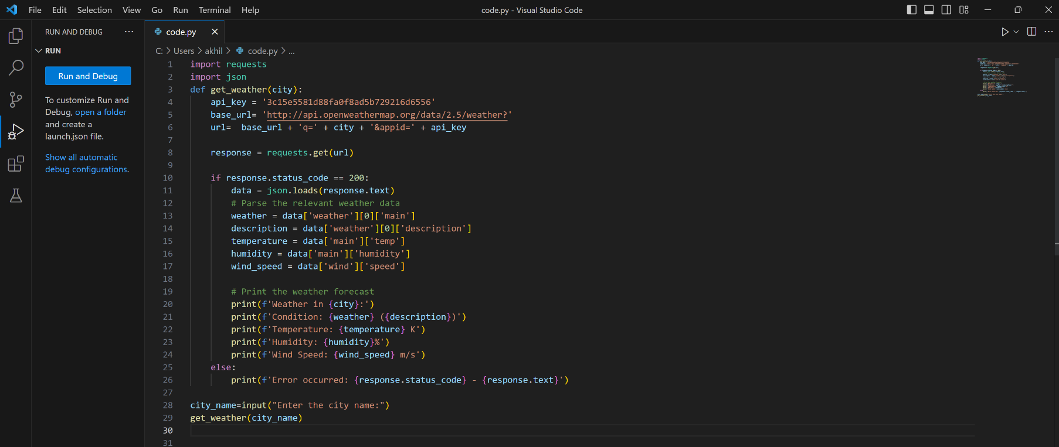
Execution Demo(Video/Screenshots) showing usage of the GitHub Copilot Platform :
Code:

Slide 10
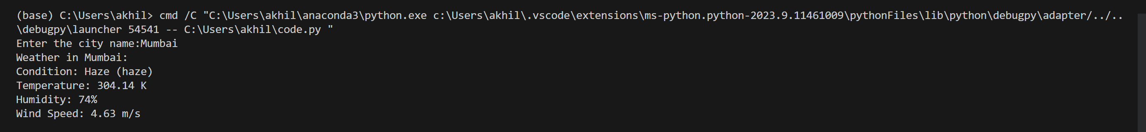
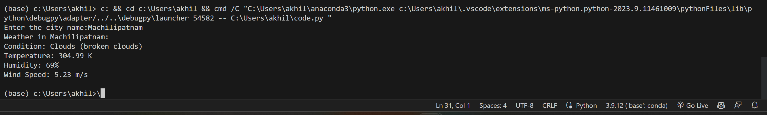
Execution Demo(Video/Screenshots) showing usage of the GitHub Copilot Platform :
Output:
Working under GitHub Copilot
Working under Github copilot

Slide 11
Additional comments (optional):
The project showcases the power of leveraging APIs, such as the OpenWeatherMap API, to retrieve real-time weather data.
It demonstrates how Python, along with tools like GitHub Copilot, can streamline the process of working with APIs, parsing data, and handling errors.
This command-line tool can be extended and customized to cater to various use cases and industries, providing valuable weather information for decision-making and planning purposes.

Slide 12
THANK YOU

